Slide 1
Linear Regression

Slide 2
Regression
A statistical measure that determine the strength of the relationship between the
one dependent variable (y) and other independent variables (x1, x2, x3……)
This is done to gain information about one through knowing values of the others.
It is basically used for predicting and forecasting.

Slide 3
Linear Regression
The simplest mathematical linear relationship between two variables x and y.
The change in one variable make the other variable change.
In other words a dependency of one variable to other.

Slide 4
Linear Regression Mathematical Model
𝑌 = 𝑏₀ + 𝑏₁ ∗ 𝑋+ ∈
Y = Dependent Variable
X = Independent Variable b₀ = Y - Intercept
b₁ = Slope of the line
∈ = Error Variable

Slide 5
Understanding Linear Regression
y = mx + c
3.6 = 0.2*3 + c → c = 3
x | y | x - ẋ | y - ẏ | (x − ẋ )² | (x - ẋ)(y - ẏ)
1 | 3 | -2 | -0.6 | 4 | 1.2
2 | 4 | -1 | 0.4 | 1 | -0.4
3 | 4 | 0 | 0.4 | 0 | 0
4 | 2 | 1 | -1.6 | 1 | -1.6
5 | 5 | 2 | 1.4 | 4 | 2.8
6
5
4
Y - AXIS
3
2
3
3.6
෍ =
10
෍ =
Mean
2
σ
x − ẋ (y − ẏ )
2
m =
=
10
1
σ
(x − ẋ )²
0
y = 0.2x + 3
0
1
2
3
X - AXIS
4
5
6

Slide 6
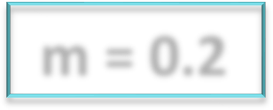
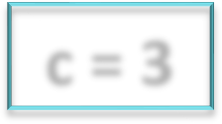
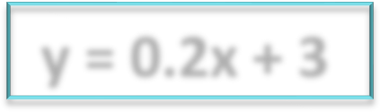
Mean Square Error
6
m = 0.2 c = 3 y = 0.2x + 3
5
5
4
4
4
For these values, the predicted values for y for x = (1,2,3,4,5) will be -
4
3.8
3.6
3.4
3.2
3
Line Of Regression
Y - AXIS
y = 0.2 * 1 + 3 = 3.2
y = 0.2 * 2 + 3 = 3.4
y = 0.2 * 3 + 3 = 3.6
y = 0.2 * 4 + 3 = 3.8
y = 0.2 * 5 + 3 = 4.0
3
2
2
1
0
0
1
2
3
X - AXIS
4
5
6

Slide 7
R - Square
R – Squared value is a measure of how close the data is to the fitted regression line.
It is also known as Coefficient of Determination.
σ
(y_{p} − ẏ )²
R² =
σ
(y − ẏ )²

Slide 8
Calculation 0f R²
x | y | y - ẏ | (y - ẏ)² | y_{p} | y_{p} - ẏ | (y_{p} − ẏ )²
1 | 3 | -0.6 | 0.36 | 3.2 | -0.4 | 0.16
2 | 4 | 0.4 | 0.16 | 3.4 | -0.2 | 0.04
3 | 4 | 0.4 | 0.16 | 3.6 | 0 | 0
4 | 2 | -1.6 | 2.56 | 3.8 | 0.2 | 0.04
5 | 5 | 1.4 | 1.96 | 4.0 | 0.4 | 0.16
Mean
3
3.6
^{෍ =} 5.2
^{෍ =} 0.4
R² =
𝟎. 𝟒
≈
0.08
𝟓. 𝟐

